Slide 1
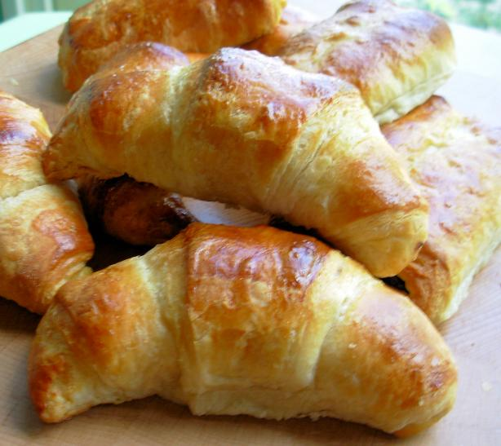
French Recipes

Slide 2
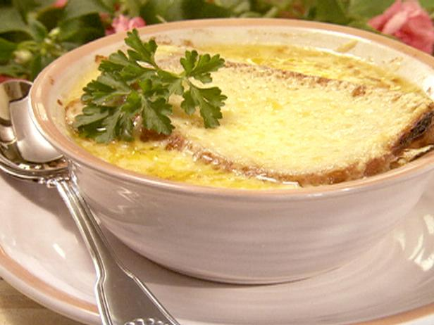
French Onion Soup
Original recipe make 4-6 bowls of soup
Ingredients
8 onions, sliced
2 cloves garlic, minced
1/3 cup olive oil
2 tablespoons all-purpose flour
8 cups beef stock
1/4 cup dry white wine
1/2 teaspoon dried thyme
1 bay leaf
Salt and pepper
1 loaf French bread
2 cups grated Gruyere
Directions Sauté onions and garlic in oil over low heat until tender and golden yellow. Sprinkle flour over onions, cook a few minutes more, browning the flour well. Add stock and wine and bring to a boil, add thyme and bay leaf. Reduce heat, cover, and simmer gently for 20 minutes or so. Add salt and pepper, to taste. Meanwhile, slice French bread into 3/4-inch slices and butter both sides. Toast slices on griddle until golden brown. Ladle soup into an ovenproof bowl, add toasted bread and cover with cheese. Place ovenproof bowl on a baking sheet lined with tin foil. Bake at 350 degrees F or 5 minutes under a hot broiler.

Slide 3
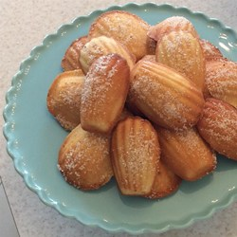
Madeleine (French Butter Cakes)
Original recipe makes 1 dozen Servings
Ingredients
2 eggs
3/4 teaspoon vanilla extract
1/8 teaspoon salt
1/3 cup white sugar
1/2 cup all-purpose flour
1 tablespoon lemon zest
1/4 cup butter
1/3 cup granulated sugar for decoration
Directions
Preheat oven to 375 degrees F (190 degrees C). Butter and flour 12 (3 inch) Madeleine molds; set aside.
Melt butter and let cool to room temperature.
In a small mixing bowl, beat eggs, vanilla and salt at high speed until light.
Beating constantly, gradually add sugar; and continue beating at high speed until mixture is thick and pale and ribbons form in bowl when beaters are lifted, 5 to 10 minutes.
Sift flour into egg mixture 1/3 at a time, gently folding after each addition.
Add lemon zest and pour melted butter around edge of batter. Quickly but gently fold butter into batter. Spoon batter into molds; it will mound slightly above tops.
Bake 14 to 17 minutes, or until cakes are golden and the tops spring back when gently pressed with your fingertip.
Use the tip of the knife to loosen Madeleine's from pan; invert onto rack. Immediately sprinkle warm cookies with granulated sugar. Madeleine's are best eaten the day they're baked. Leftover Madeleine's are wonderful when dunked into coffee or tea.
.

